Slide 1


STRENGTHENING OUR COMMUNITY: ADDRESSING VACANT PROPERTIES
CODE ENFORCEMENT TEAM

Slide 2


  Causes for long-term vacant properties
  Consequences of long-term vacant properties - Attractive Nuisance
  Identifying vacant properties
  The Code Enforcement Process
  Code Enforcement Success Stories
  How you can help!

Slide 3
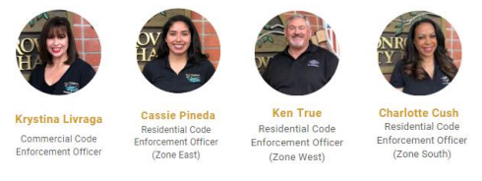
MEET YOUR CODE ENFORCMENT TEAM

Slide 4

Causes for Long-Term Vacant Properties
  Deceased Owners
    Probate Court, Family Member
  Foreclosed or Bank Owned
    Locating the responsible bank
  Squatters
    Property owner and eviction process
  Commercial Development
    Working with Developers through the entitlement process

Slide 5
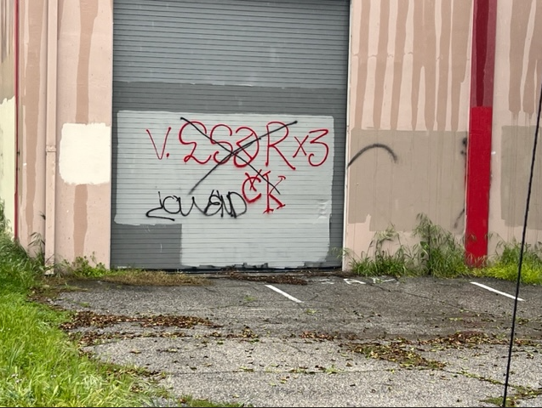
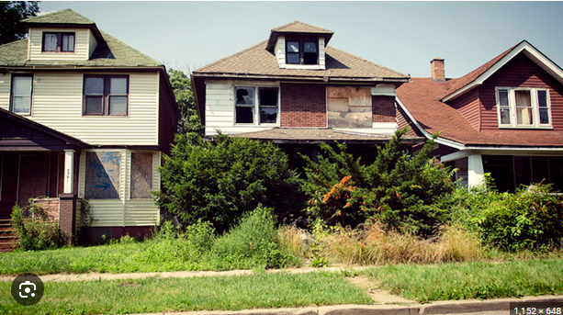
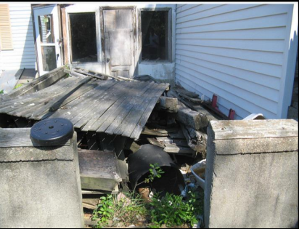
Consequences of
Vacant Properties
  Attract Criminal
Activity (graffiti)
  Decreases Surrounding Property Values
  Public Health Hazards
  Impact on Neighborhood Aesthetics

Slide 6
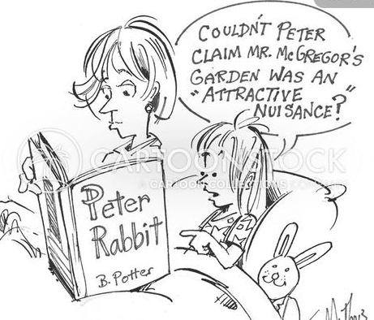
What is an Attractive Nuisance?
Any condition, device, equipment, instrument, item or machine that is unsafe, unprotected and may prove detrimental to the public whether in a structure or in outdoor areas of developed or undeveloped real property.

Slide 7
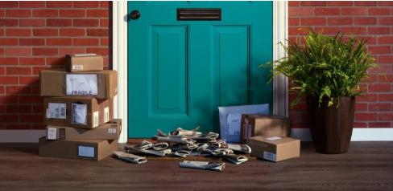
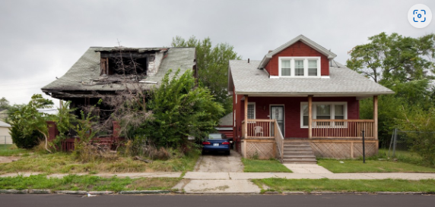
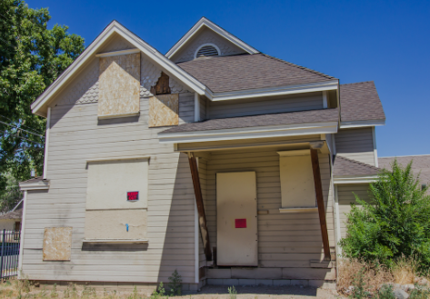
Identifying Vacant Properties
  Neglected maintenance
  Not seeing anyone come in or out for a long period of time.
  Car(s) in driveway not moving.
  Piles of mail or overflowing mailbox
  Boarded up windows/doors

Slide 8

Steps for Code Enforcement Compliance
  Research Property Information
  Initial Inspection to Verify Conditions
  Attempt Communication with Property Owner
  Notice of Violations/Corrective Actions/No Trespass Authorization
  Follow-up Inspections to Verify Compliance
  Enforcement Actions if Needed
  Ensure Compliance by Monitoring the Property until Occupied or Demolished

Slide 9


Slide 10

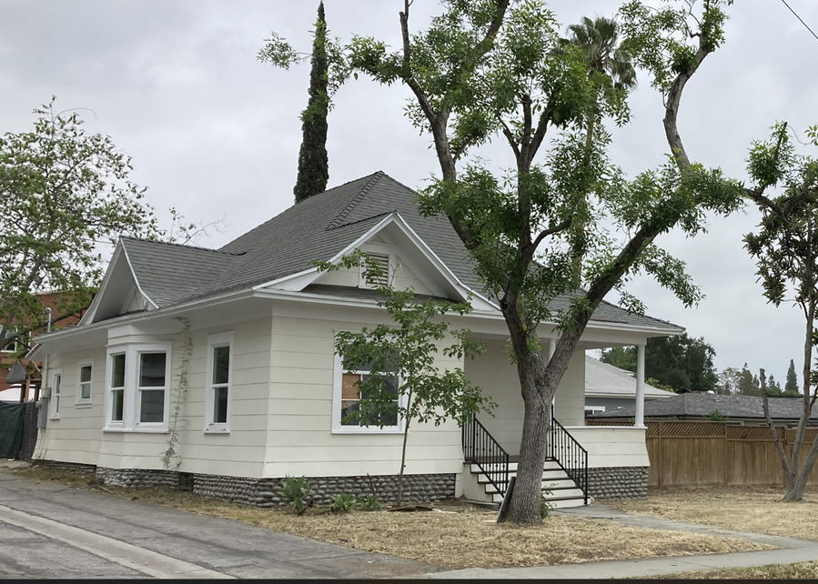
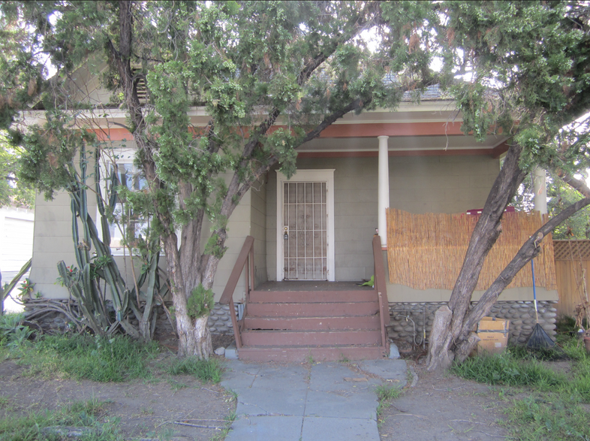


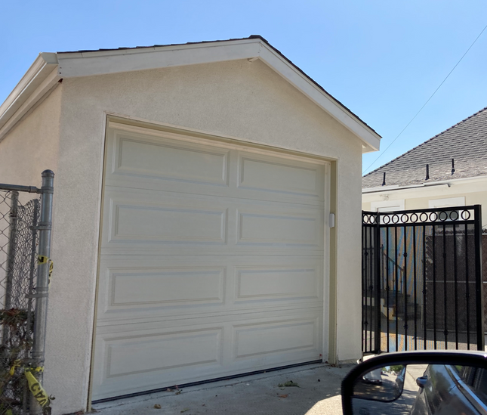
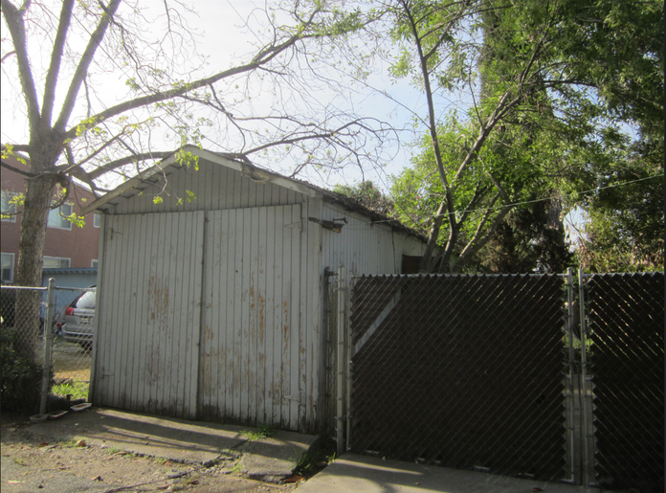
Officer Cassie Pineda

Slide 11
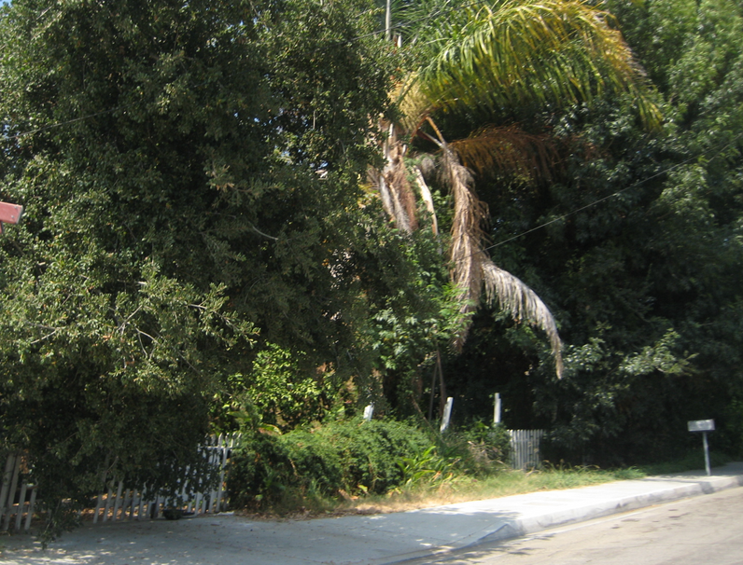

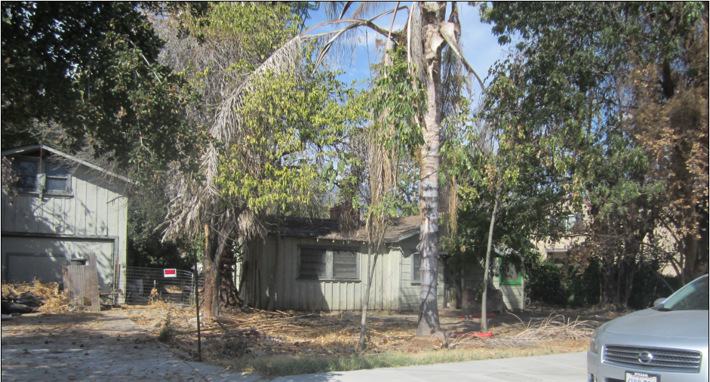
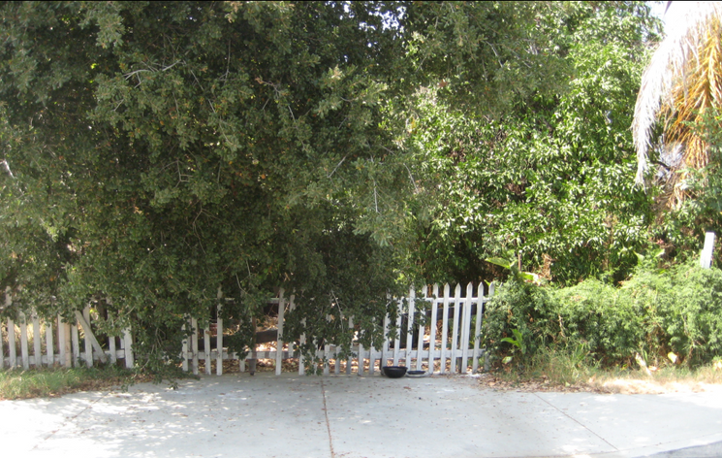
Officer Ken True

Slide 12

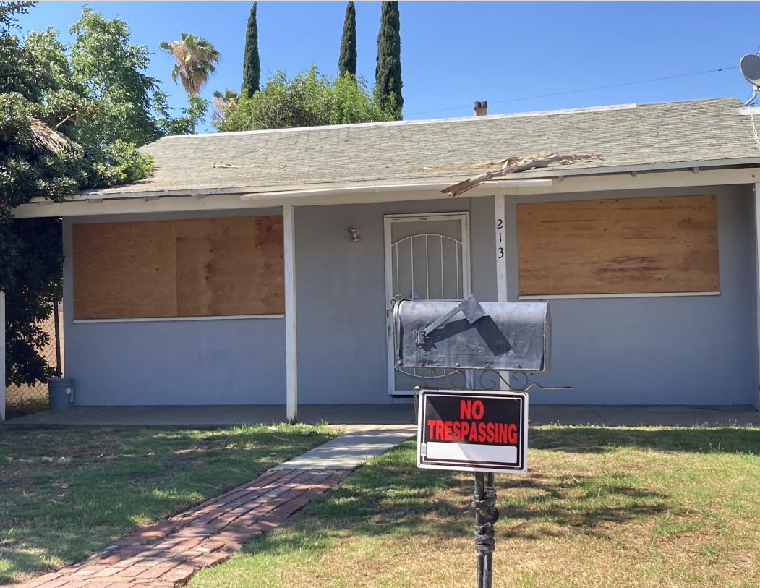
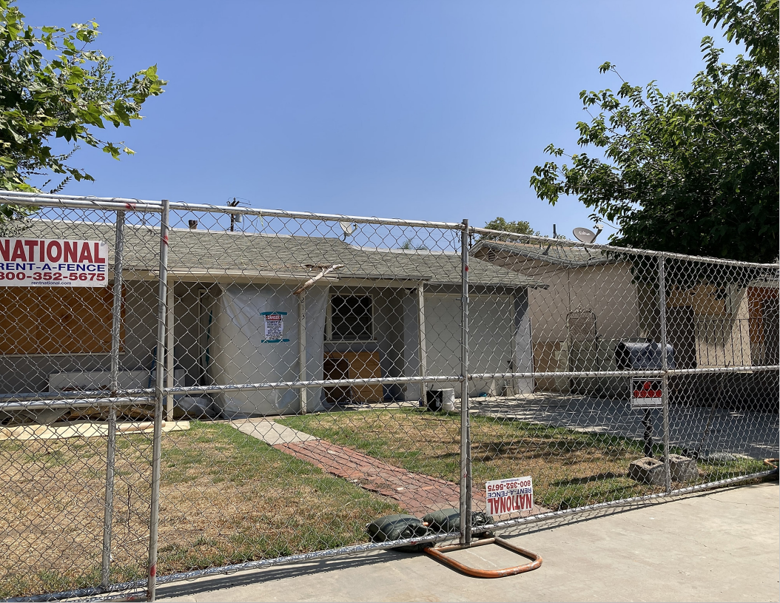
Officer Charlotte Cush

Slide 13
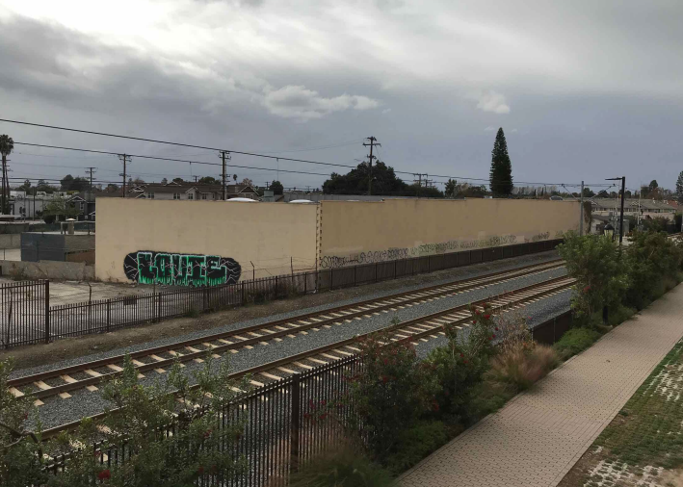
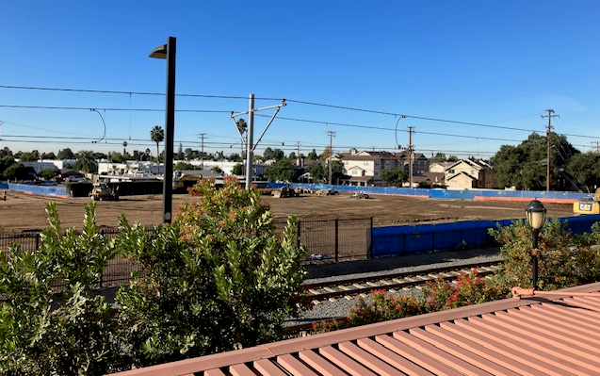
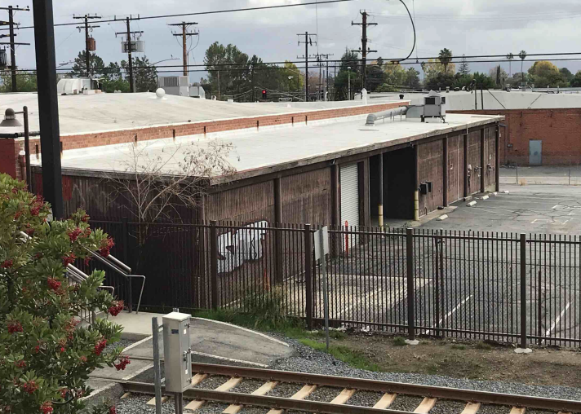
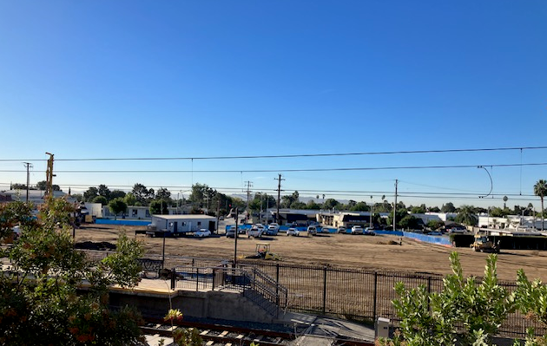
Officer Krystina Livraga

Slide 14

How You Can Help!
If You See Something
Say Something
  Illegal Activity / Trespassing
  Property Looks Unsecure
  Signs of Neglect / Property Maintenance
    Accumulation of trash
    Overgrown landscaping
    Graffiti

Slide 15
CONTACT INFORMATION
Code Enforcement Email
ce@ci.monrovia.ca.us
Code Enforcement Phone
(626)932-5582
Non-Emergency Police Line
(626) 256-8000

Slide 16


