Slide 1
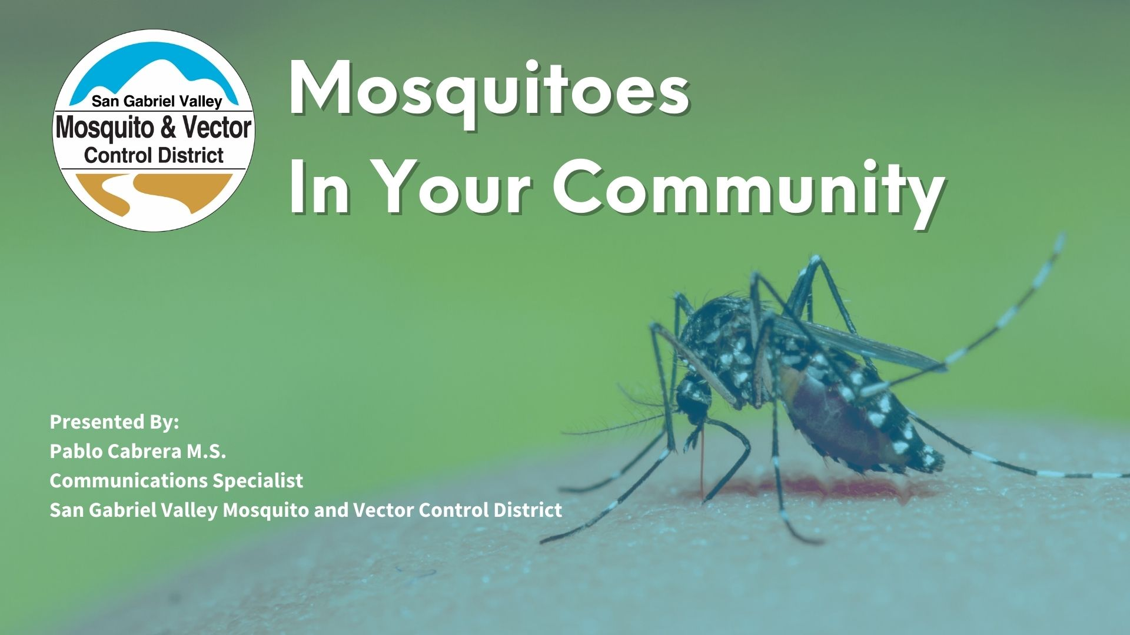

Slide 2
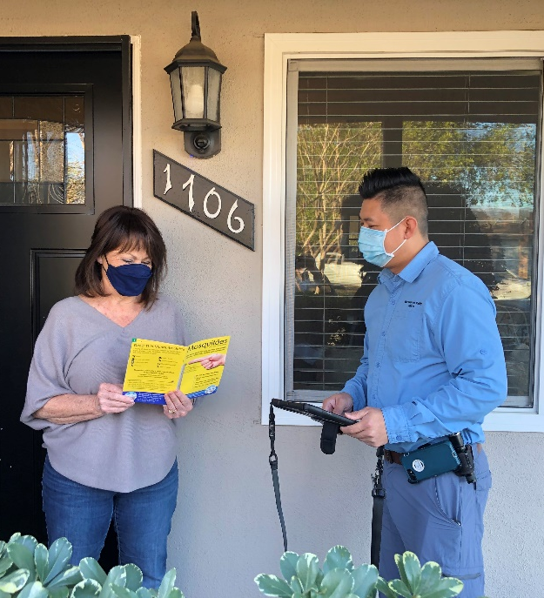
San Gabriel Valley Mosquito & Vector Control District
We monitor and control for mosquito-borne disease outbreaks in the community while residents keep their properties bite-free.
By the numbers:
We serve 26 cities and unincorporated L.A. County communities in San Gabriel Valley
1.5 million residents
We have 37 full-time employees

Slide 3
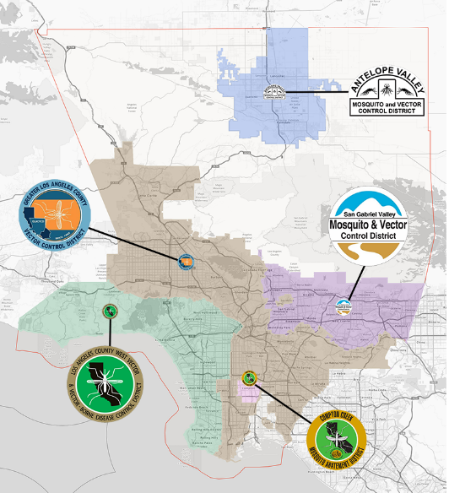
SGV Mosquito is one of five mosquito control districts that serve LA County.
Visit www.SoCalMosquito.org to find your local mosquito control district.
Notes:
We’re one of five mosquito control districts serving LA County. Visit https://www.socalmosquito.org/ to find your local district

Slide 4
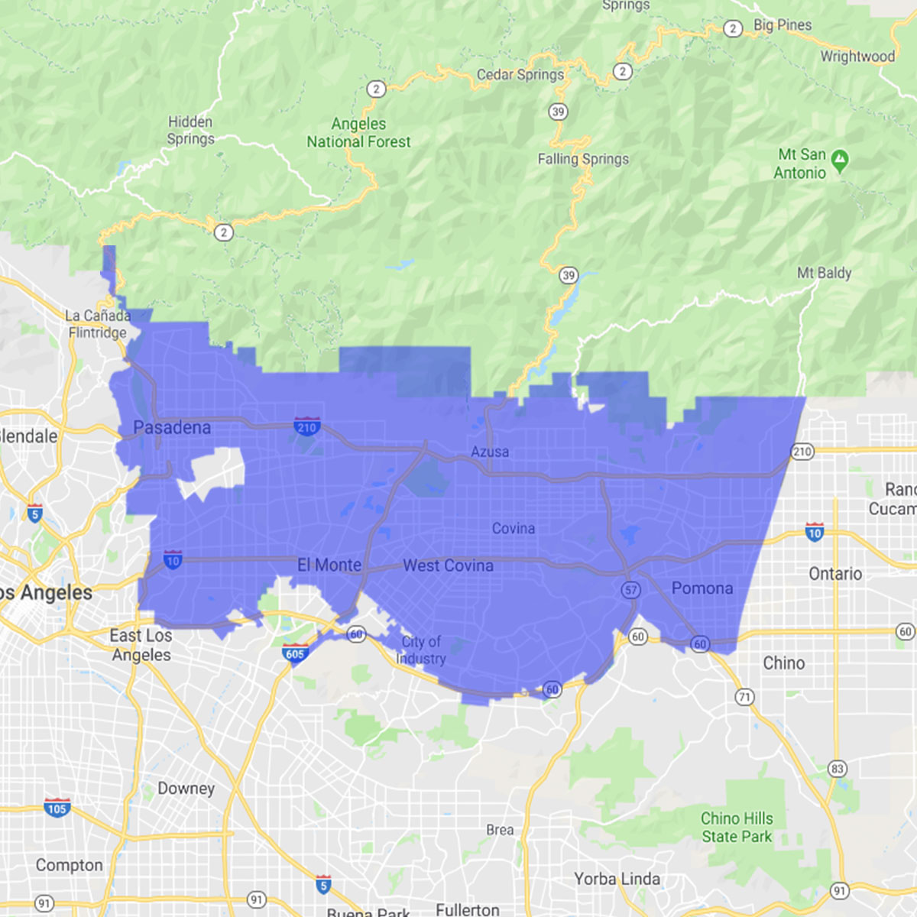
Notes:
We’re one of five mosquito control districts serving LA County. Visit https://www.socalmosquito.org/ to find your local district

Slide 5
San Gabriel Valley Mosquito & Vector Control District

Slide 6
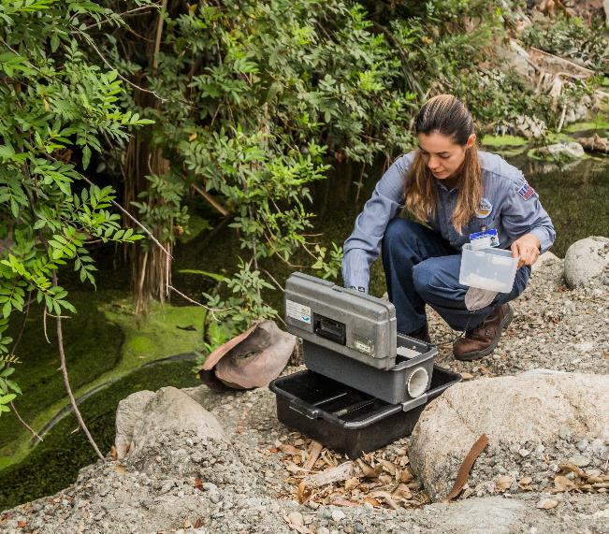
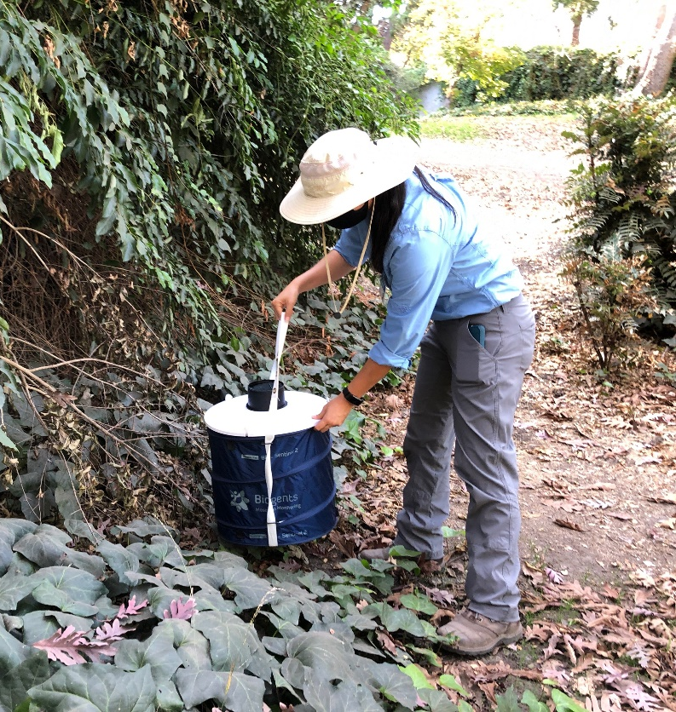
San Gabriel Valley Mosquito & Vector Control District

Slide 7
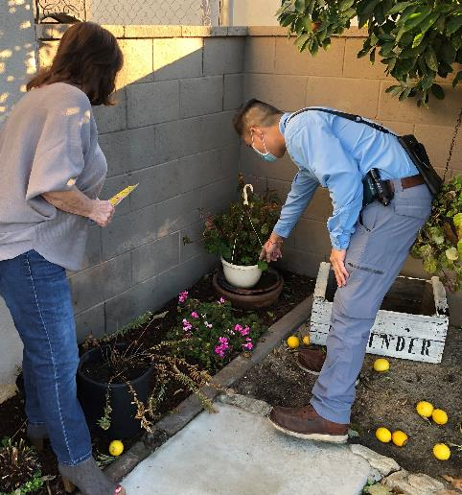
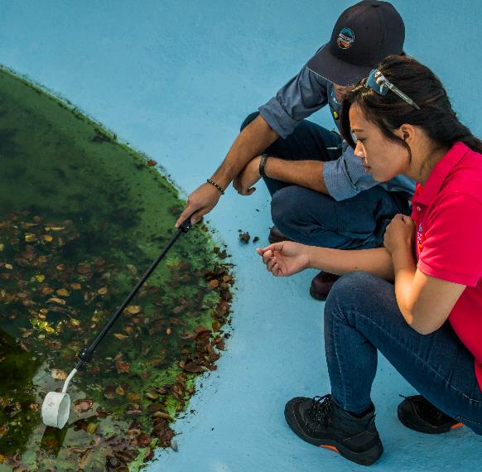
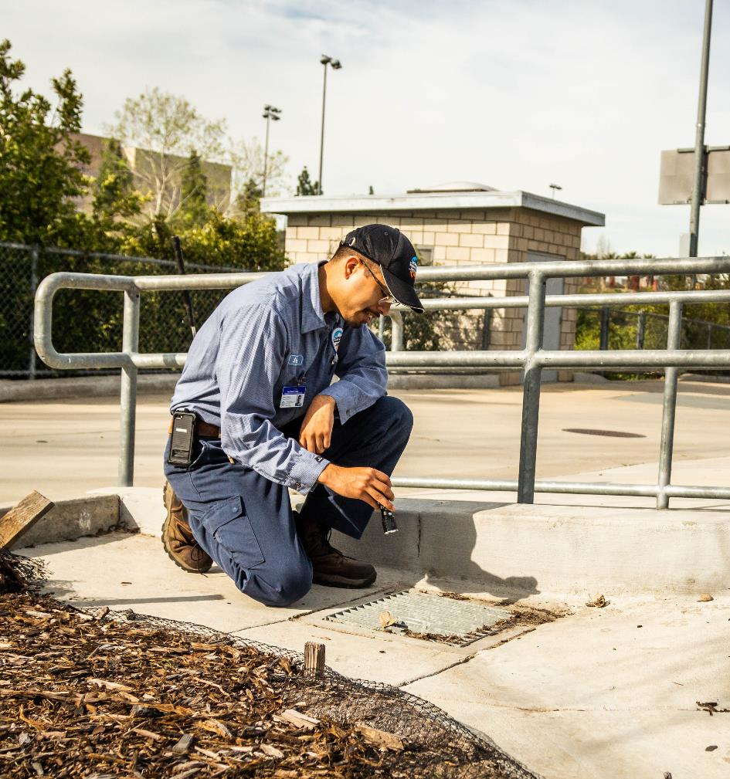
San Gabriel Valley Mosquito & Vector Control District

Slide 8
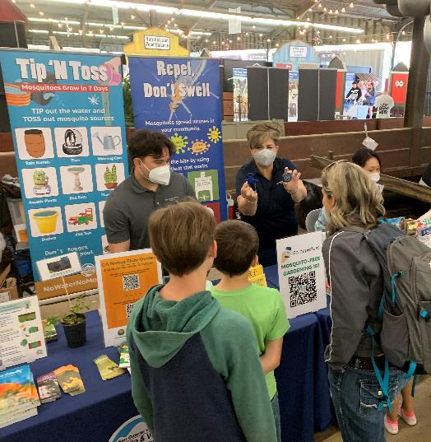
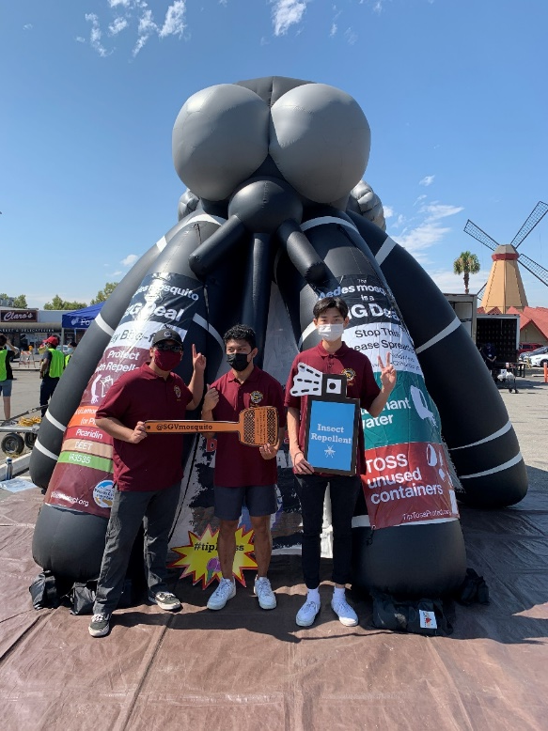
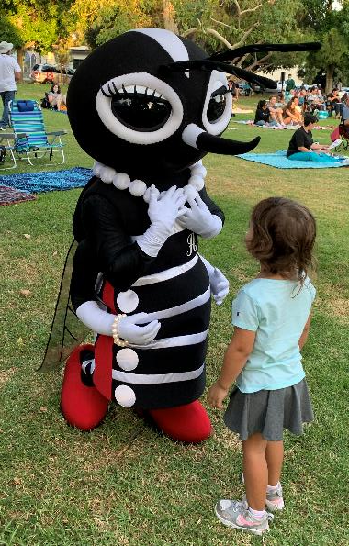
San Gabriel Valley Mosquito & Vector Control District
@ada_eez

Slide 9
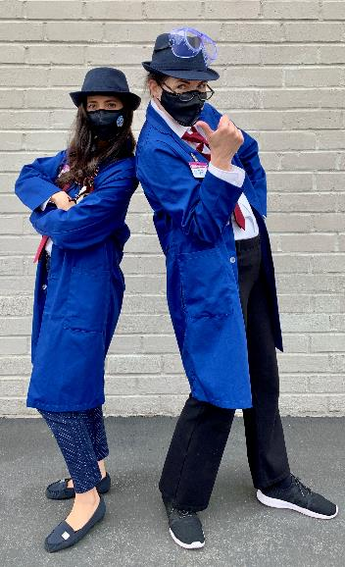
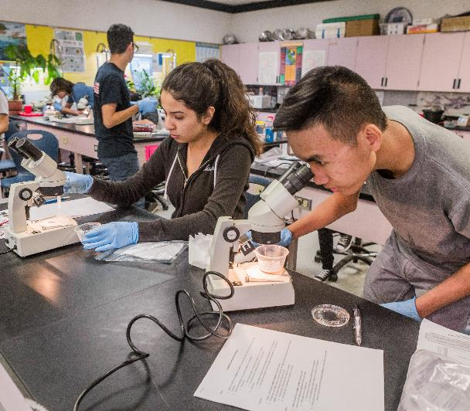
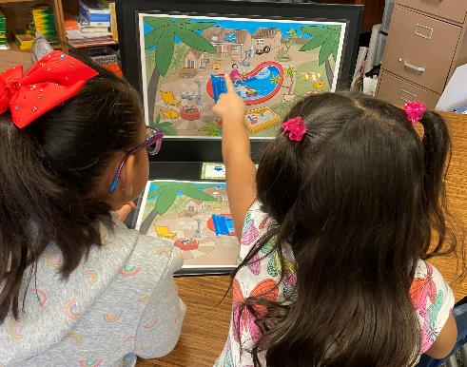

San Gabriel Valley Mosquito & Vector Control District

Slide 10
Back to the Biology
Notes:
Control options can be implemented at different stages of the mosquito life cycle.

Slide 11
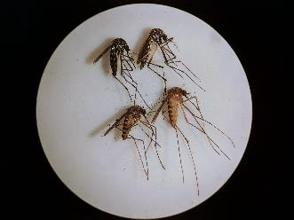
How many types (species) of mosquitoes are there in the world?
~ 3,500

Slide 12
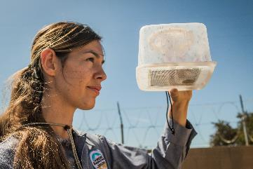
How many kinds of mosquitoes do we catch regularly in our District?
~ 10

Slide 13
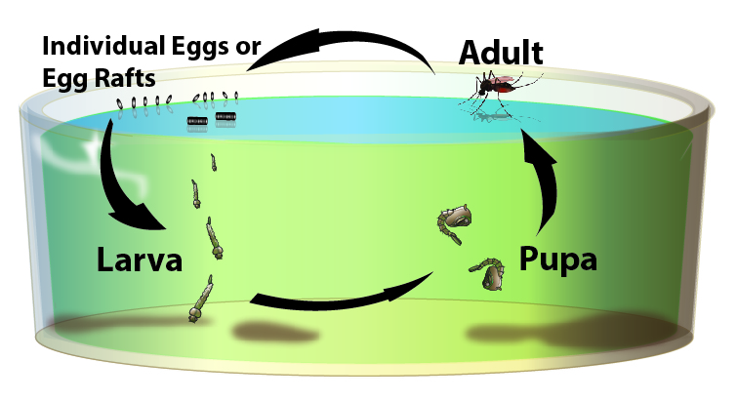
Mosquito Life Cycle
Complete in 7-10 days!
Notes:
Control options can be implemented at different stages of the mosquito life cycle.

Slide 14
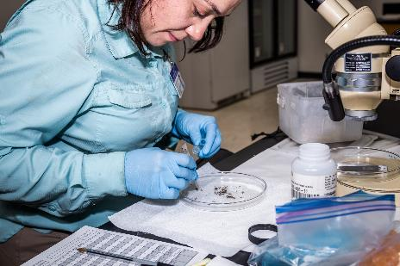
Why do we care about mosquitoes in our cities?
They are carriers of diseases!
Notes:
Elimination of stagnant water

Slide 15
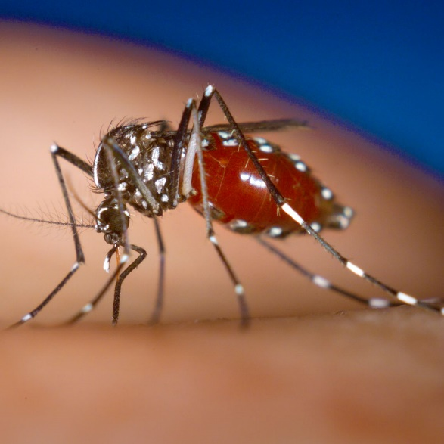
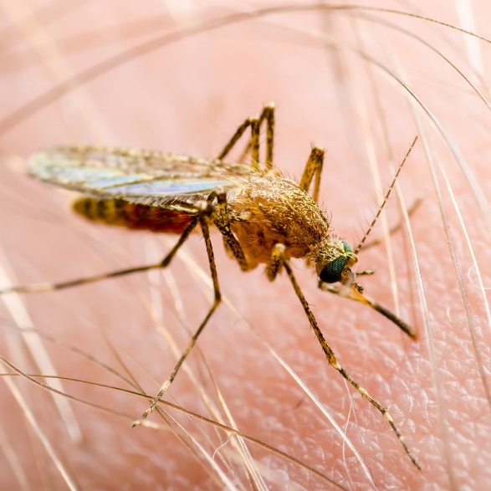
Two genera of mosquitoes that transmits arboviruses to people in our cities
Aedes
Culex
Notes:
40-90 degree angle vs parallel feeding

Slide 16
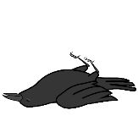
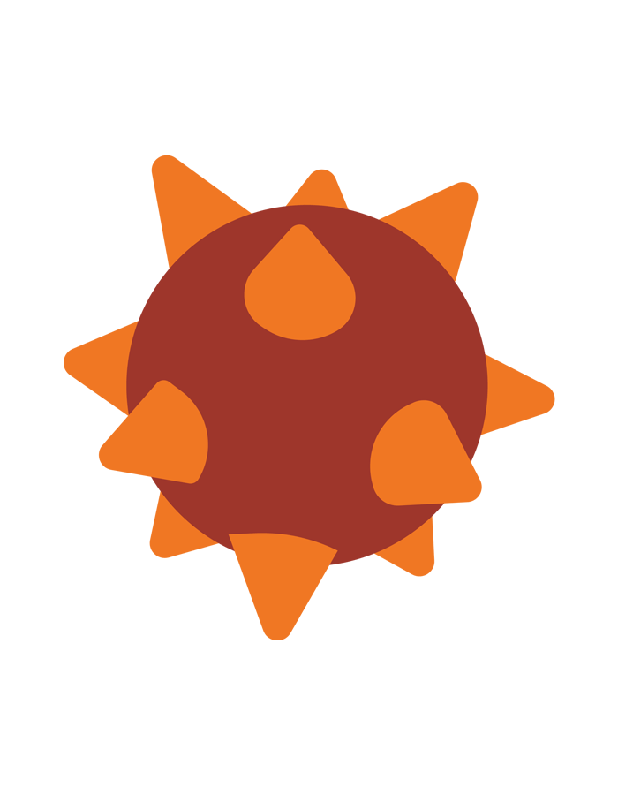
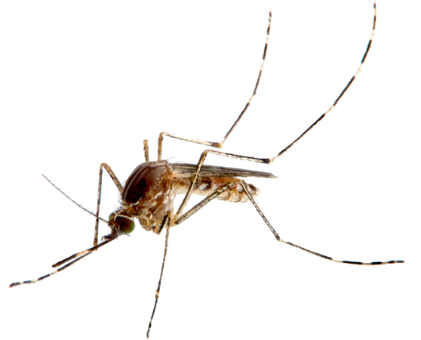
Culex genus
Native Culex mosquitoes prefer to bite birds
  Dead bird surveillance is key
2. Culex mosquitoes can spread West Nile virus
(“Bird disease”) when they bite
  Detected in L.A. County in 2004
  Flu-like symptoms for 1 in 5 people infected
  Central nervous system affected for 1 in 150 people infected
    Encephalitis (inflammation of the brain)
    Meningitis (inflammation of membranes that surround brain and spinal cord)

Slide 17
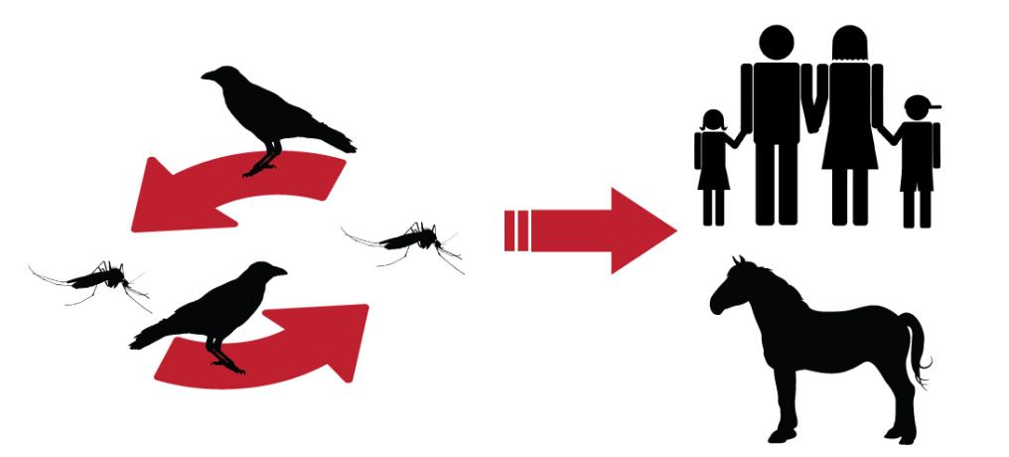
West Nile virus transmission pathway

Slide 18
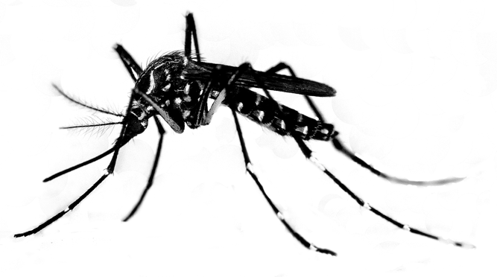
Aedes genus (“ankle biters”)
Invasive Aedes mosquitoes prefer to bite people
Aedes make outbreaks of Zika, yellow fever, dengue fever, and chikungunya possible
Bites all day from dawn to dusk

Slide 19
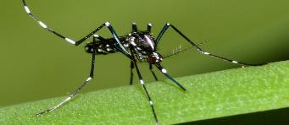
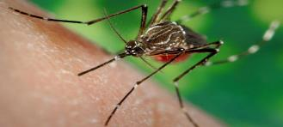
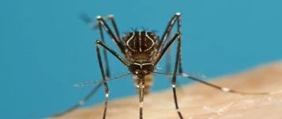
Invasive Aedes Mosquitoes in our District
Only Female
Mosquitoes
Bite
Ae. albopictus
2011
Ae. aegypti
2013
Ae. notoscriptus
2014
Notes:
Years discovered/ re-discovered in California

Slide 20
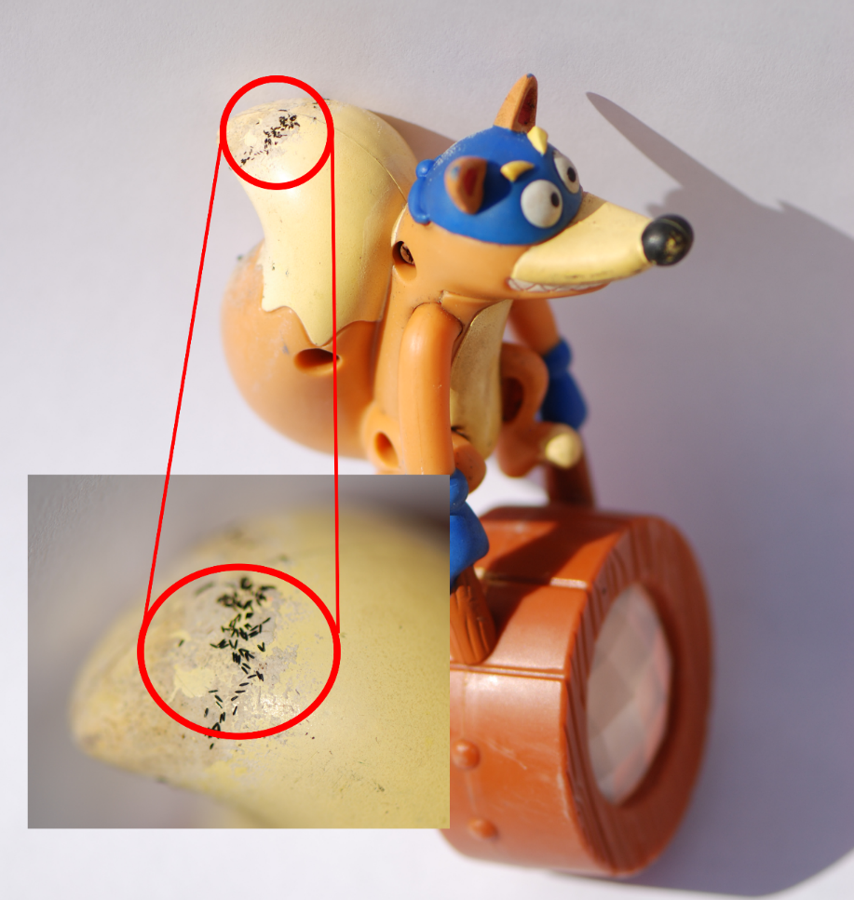
Aedes Mosquitoes’ Eggs = Time Capsules
Lays individual eggs on any surface above the water line

Slide 21
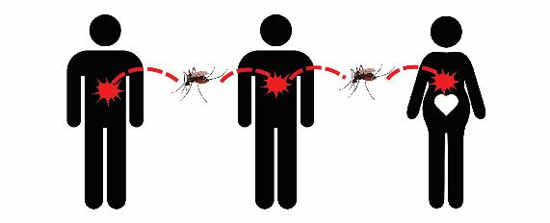
Zika, yellow fever, dengue fever, and chikungunya

Slide 22




Travel Associated Cases

Slide 23
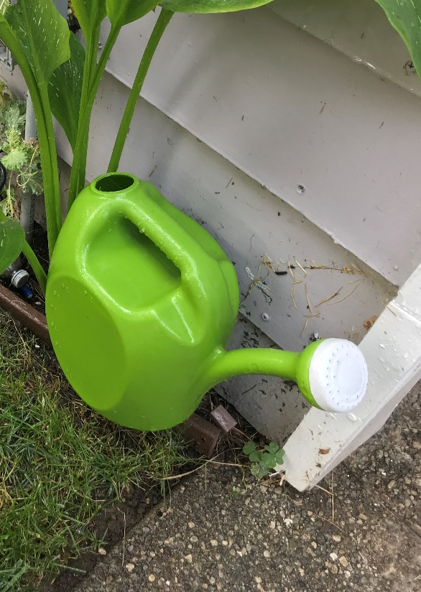
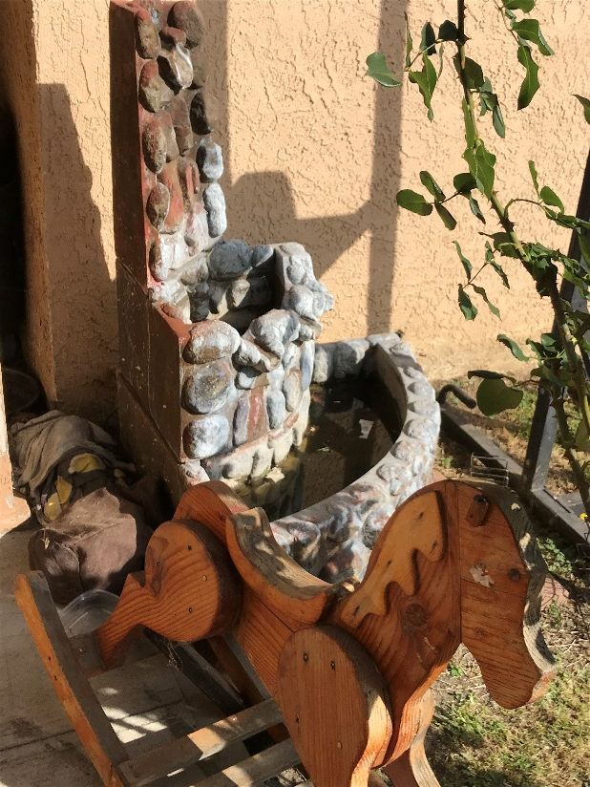
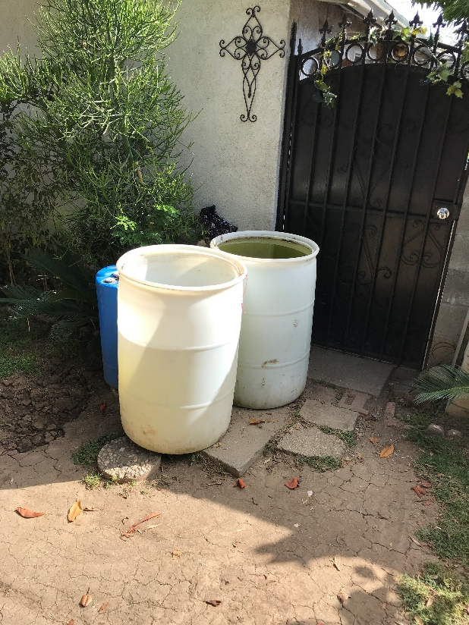
Mosquito Sources
Notes:
Control options can be implemented at different stages of the mosquito life cycle.

Slide 24

Tip, Toss, and Protect
Notes:
Elimination of stagnant water

Slide 25
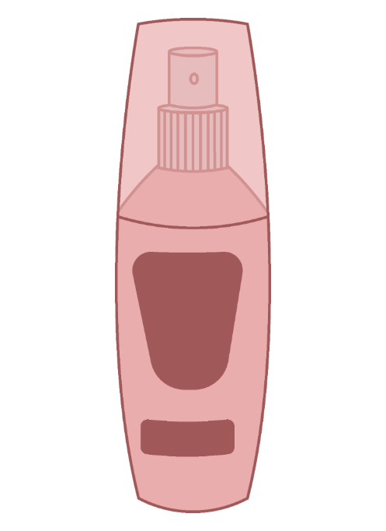
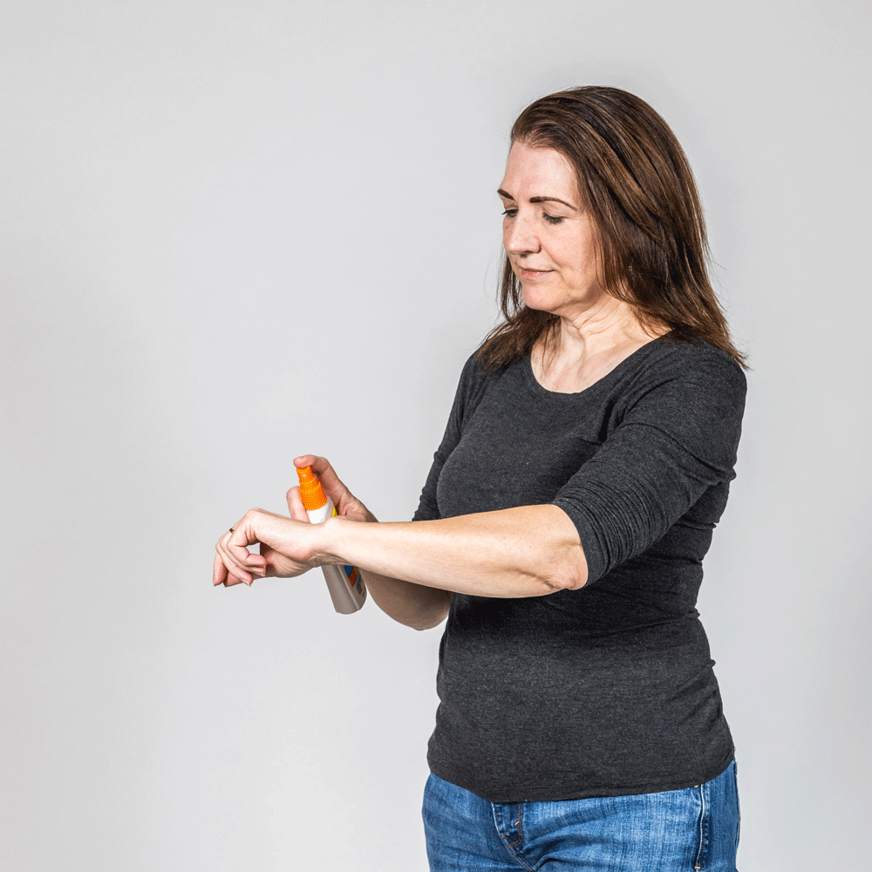
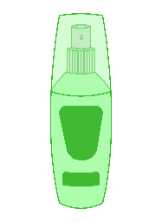
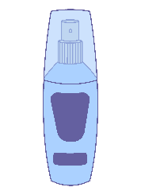
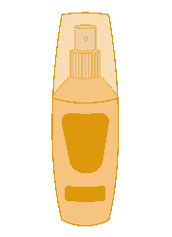
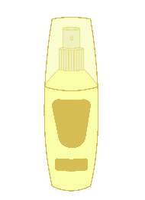
Mosquito Repellents

Slide 26

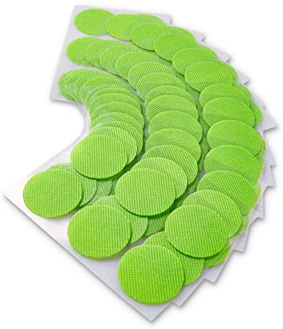
Myth: Wearable Repellents

Slide 27

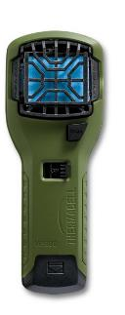
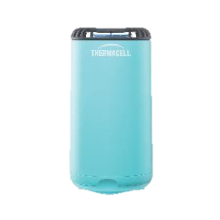
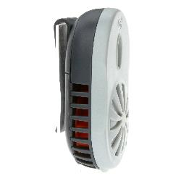
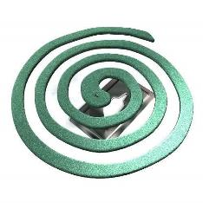

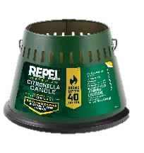
Myth: Shield of Protection

Slide 28
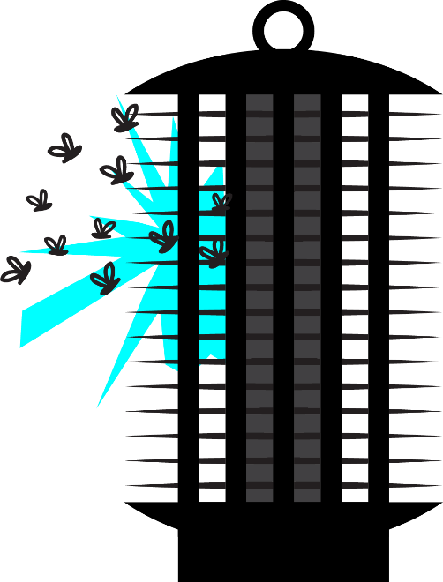
Myth: The Zappers
Kills mostly beneficial insects

Slide 29
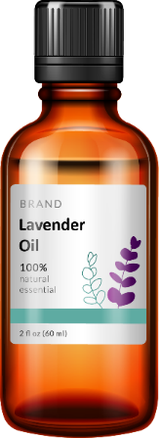

Myth: On-skin Repellents
Dryer sheets
Essential oils
Not proven to work
Need to reapply at least once every 15 minutes
Not regulated

Slide 30

Repel Mosquito Bites Safely and Effectively
Well-researched CDC-recommended and EPA-registered active ingredients
Oil of lemon eucalyptus
DEET
Picaridin
IR3535

Slide 31


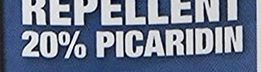
Repel Mosquito Bites Safely and Effectively
Percentages matter
The longer you’re staying outside, the higher the percentage
People may need 20%-30% of active ingredient for most outdoor activities that last longer than 3 hours

Slide 32
Repellent – Check
Remove stagnant water - Check
Then why am I still seeing mosquitoes or getting bites!?!
Notes:
Elimination of stagnant water

Slide 33
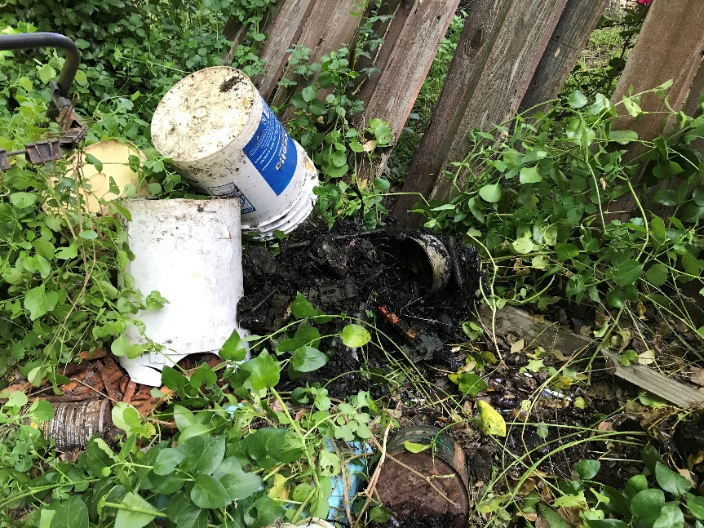

Don’t Forget to Cut What Covers
Adult mosquitoes hide from the heat in dense vegetation.
Dense vegetation usually includes non-native plants, such as bromeliads, or plants that can provide plenty of ground-level shade.
Notes:
Elimination of stagnant water

Slide 34


Ditch the bromeliads
Center cups can hold water and invite mosquitoes to lay hundreds of eggs inside.
Notes:
Elimination of stagnant water

Slide 35


Landscape Mosquitoes out with California Native Plants
Notes:
Elimination of stagnant water

Slide 36
The Future
Notes:
Elimination of stagnant water

Slide 37
Sterile Insect Technology (SIT)
Notes:
Elimination of stagnant water

Slide 38
Sterile Insect Technology (SIT)
Notes:
Elimination of stagnant water

Slide 39


MIDGES
SWARM
Non-biting insect
Not a vector
Active in the afternoon
Season: April – August
  Heat increases

Slide 40

TIP, TOSS, AND PROTECT
  Tip stagnant water from containers weekly
  Toss unused containers
  Protect with insect repellent
    DEET
    Oil of Lemon Eucalyptus (or PMD)
    Picaridin
    IR3535
  Create a Bite Back Group in your neighborhood at www.BiteBackChampion.org
  Submit a Tip to 626-814-9466 or www.SGVMosquito.org

Slide 41




THANK YOU
  Pablo Cabrera
  Communications Specialist
  San Gabriel Valley Mosquito and
  Vector Control District
  Pcabrera@SGVmosquito.org
  626-814-9466
@SGVmosquito

